Slide 1
Box Platform Developer Workshop
Jonathan LeBlanc
Director of Developer Advocacy, Box
Twitter: @jcleblanc
Github: https://github.com/jcleblanc

Slide 2
Collaboration and Permissioning

Slide 3
Permission Structure

Slide 4
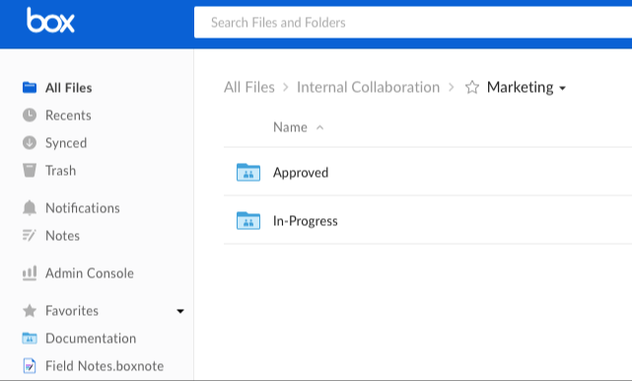
Folder Permission Model
Waterfall permission model for folders
When users are collaborated in on a folder they can view all files / folders under that folder.

Slide 5
Common Folder Models
Duplicate Folders for each User
A folder model is created and duplicated for each user. Collaborators or groups are added at each level.
App User 1
App User 2
Config
Config
User Data
User Data
Personnel
Personnel
Operations
Operations

Slide 6
Common Folder Models
Business Level Ownership
Enterprise Admin
The Box enterprise admin, or appropriate leadership level, would maintain the root folder level.
Each business level is maintained under that level, where major business units may have minor units located underneath.
Marketing
Sales
Products
Parts & Services
Engineering

Slide 7
Collaborations

Slide 8

Collaboration System
Service accounts and users start by only being able to access content in their own accounts.
For those accounts to access content from other accounts they will need to be collaborated in on content.
Users can be collaborated via ID, email, or group ID.

Slide 9
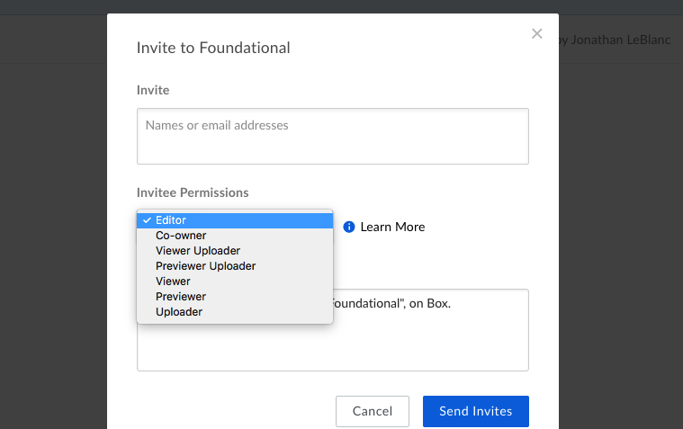
Collaboration Types
co-owner: Full access
editor: Full access minus invites / settings
previewer: Basic view and edit
previewer uploader: Previewer + uploader
uploader: Upload, basic metadata, and view
viewer: Preview + download and send links
viewer uploader: Viewer + uploader
Notes:
Full description of roles: https://community.box.com/t5/Collaborate-By-Inviting-Others/Understanding-Collaborator-Permission-Levels/ta-p/144

Slide 10
Links and Code Samples

Slide 11
Code Samples
Collaborations and Permissions
Add Collaborators to a Folder: https://github.com/jcleblanc/box-workshops/blob/master/collaboration/collaborate_add.js
Remove a Collaboration: https://github.com/jcleblanc/box-workshops/blob/master/collaboration/collaborate_remove.js

